Slide 1
Leukemia Prediction using Random Forest Algorithm
Group ID : 17CP04
Guide : Prof. Nora Naik Co-Guide : Prof. Basil Jose
Peter Braganza 14CO03
Aaron Cordeiro 14CO06
Ronan D’Souza 14CO08
Rayster Fernandes 14CO12

Slide 2
Image Pre-processing and feature extraction UI
Extraction of connected components and k-NN, Random forest Implementation
Comparison of k-NN and Random forest

Slide 3
Proposed System
Image Acquisition
Classifier for Leukemia Prediction
Image Pre-processing
Feature Extraction
WBC Segmentation

Slide 4
The proposed system for ALL prediction various functional modules.
Image Acquisition
    Images will be obtained from dataset of microscopic images of blood samples maintained by Dr.Fabio Scotti.
Image Pre-processing
    For successful segmentation of WBC, conversion from RGB to grayscale, contrast stretching, histogram equalization and image arithmetic is done.
    The image is filtered using median filter.
WBC Segmentation
  K-Means clustering will be used to perform segmentation of WBC.
Feature Extraction
  Feature extraction means to transfer the input data into different set of features.
  Geometric features - area, perimeter and compactness since shape of the nucleus is important feature for differentiation of blasts.
  Statistical Features – Standard deviation, variance, energy and entropy.
Classifier for Leukemia
  K-Nearest Neighbours
  Random Forest

Slide 5
OUTLINE
Introduction
Related Work
Proposed System
  Image Preprocessing & Segmentation
  Feature Extraction
  Classification
References

Slide 6
INTRODUCTION
Leukaemia is a group of hematological neoplasia which usually affects blood, bone marrow, and lymph nodes.
Characterized by proliferation of abnormal white blood cells (leukocytes) in the bone marrow without responding to cell growth inhibitors.
Classified into 2 types by French-American-British (FAB) classification viz. Acute Lymphoblastic Leukemia(ALL) and Acute Myelogenous Leukemia(AML)
White blood cells fall into five categories: Neutrophil, Eosinophil, Basophil, Monocyte and Lymphocyte. Lymphocytes are responsible for ALL.

Slide 7
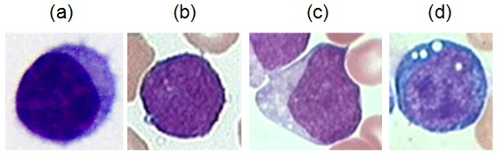
According to the most common visual morphological analysis for the ALL disease (the FAB method), the features that trained lab technicians consider during the image observation are the following:
L1: ALL blasts are small and homogeneous. The nuclei are round and regular with little clefting and inconspicuous nucleoli.
L2: ALL blasts are large and heterogeneous. The nuclei are irregular and often clefted. One or more, usually large nucleoli are present.
L3: ALL blasts are moderate-large in size and homogeneous. The nuclei are regular and round-oval in shape. One or more prominent nucleoli are present.
Morphological variability associated to the blast cells according to the FAB classification: (a) healthy lymphocytes cell from non-ALL patients, (b-d) lymphoblasts from ALL patients where (b), (c) and (d) are L1, L2 and L3 respectively.

Slide 8
According to the most common visual morphological analysis for the ALL disease (the FAB method), the features that trained lab technicians consider during the image observation are the following:
L1: ALL blasts are small and homogeneous. The nuclei are round and regular with little clefting and inconspicuous nucleoli. Cytoplasm is scanty and usually without vacuoles.
L2: ALL blasts are large and heterogeneous. The nuclei are irregular and often clefted. One or more, usually large nucleoli are present. The volume of cytoplasm is variable, but often abundant and may contain vacuoles.
L3: ALL blasts are moderate-large in size and homogeneous. The nuclei are regular and round-oval in shape. One or more prominent nucleoli are present. The volume of cytoplasm is moderate and contains prominent vacuoles.
Morphological variability associated to the blast cells according to the FAB classification: (a) healthy lymphocytes cell from non-ALL patients, (b-d) lymphoblasts from ALL patients where (b), (c) and (d) are L1, L2 and L3 respectively.

Slide 9
RELATED WORK
Edge detection method was used for segmentation but it is applicable only when there is good contrast between foreground and background. (Piuri and Scotti)
Theera-Umpon used a fuzzy C-Mean clustering to segment single cell images of white blood cells in the bone marrow into two regions, i.e., nucleus and non-nucleus. The computational time increases if the clusters number is greater than 2.
T. Markiewicz and S. Osowski Support Vector Machine (SVM) classifier and exploit features in blood cell images that related to texture, geometry and statistical analysis.
Mario Colunga and Oscar Siordia use EM-Algorithm to recognize types of leukocyte. EM-algorithm distribution function of each is used to get the parameters to model the probability class of cells. Classification is done by choosing the class with the highest probability using Bayes’ Theorem.

Slide 10
IMAGE PREPROCESSING AND SEGMENTATION

Slide 11
Image Preprocessing & Segmentation
This section shows steps of the algorithm used in this system.
  1) Input the colour blood slide image to the system.
  2) Convert the colour image into grayscale image.
  3) Enhance contrast of the grayscale image by histogram equalization method (A).
  4) To adjust image intensity level apply contrast stretching to grayscale image (B).
  5) Obtain the image I1=B+A to brighten all other image components except cell nucleus.
  6) Obtain the image I2=I1-A to highlight the entire image objects along with cell nucleus.
  7) Obtain the image I3=I1+I2 to remove all other components of blood with minimum
  effect of distortion over nucleus.
  8) To reduce noise, preserve edges and increase the darkness of the nuclei implement
  3-by-3 median filter on the image I3.
  9) Use K-Means Clustering on image I3 to get binary image.
  10) To remove small pixel groups use morphological opening.

Slide 12
1. Image Acquisition
Images will be obtained from a public and free dataset of microscopic images of blood samples maintained by Dr.Fabio Scotti, specifically designed for the evaluation and the comparison of algorithms for segmentation and image classification.
The images of the dataset has been captured with an optical laboratory microscope coupled with a Canon PowerShot G5 camera. All images are in JPG format with 24 bit color depth, resolution 2592 x 1944.
https://homes.di.unimi.it/scotti/all/

Slide 13
2. RGB to Grayscale Conversion
In this Phase we convert the coloured image to grayscale image.
Conversion from RGB to Grayscale is done because processing on grayscale images is much easier as compared to Colored image.
RGB pixels are Vector component whereas the Grayscale pixel are Scalar components, operations on Scalar components is much easier as compared to Vector components
Grayscale images only contain intensity information of the pixel.
Following mathematical function is used to convert RGB pixel value to corresponding grayscale value.
G(x,y)=round(0.3*R + 0.59*G + 0.11*B )
  x,y : specifies the pixel postion.
  R: RED
  G: GREEN
  B: BLUE

Slide 14
Consider following RGB matrix
90,70,9 | 120,30,50 | 70,90,100 | 60,80,120 | 150,90,130 | 90,80,100
25,4,100 | 90,80,100 | 60,80,90 | 50,60,70 | 70,50,20 | 80,60,70
60,175,79 | 100,50,60 | 60,90,100 | 50,10,30 | 31,42,50 | 80,20,55
70,80,10 | 120,35,20 | 150,30,40 | 70,15,40 | 31,41,21 | 50,25,10
25,,10,90 | 110,40,10 | 110,30,70 | 80,20,10 | 30,8,10 | 70,20,8
80,60,10 | 50,10,30 | 170,8,20 | 30,25,26 | 31,10,10 | 70,25,10
On applying the above formula we get the corresponding Grayscale matrix.
G(0,0) = ROUND(0.3 * 90 + 0.59 * 70 + 0.11 * 9) = 69
G(0,1) = ROUND(0.3 * 120 + 0.59 * 30 + 0.11 * 50) = 59
G(0,2) = ROUND(0.3 * 70 + 0.59 * 90 + 0.11 * 100) = 85
G(0,3) = ROUND(0.3 * 60 + 0.59 * 80 + 0.11 * 120) = 78
G(0,4) = ROUND(0.3 * 150 + 0.59 * 90 + 0.11 * 130) = 112
.
.
.
G(5,4) = ROUND(0.3 * 31 + 0.59 * 10 + 0.11 * 10) = 16
G(5,5) = ROUND(0.3 * 70 + 0.59 * 25 + 0.11 * 10) = 37

Slide 15
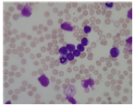
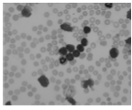
The resulting grayscale matrix
69 | 59 | 85 | 78 | 112 | 85
21 | 85 | 75 | 58 | 53 | 67
130 | 66 | 82 | 24 | 40 | 42
69 | 59 | 68 | 34 | 36 | 31
23 | 58 | 58 | 37 | 15 | 34
61 | 24 | 58 | 33 | 16 | 37
RGB
Grayscale

Slide 16
3. Histogram Equalization
Histogram equalization is used to adjust image intensities to enhance the contrast of the image.
Through this adjustment, the intensities can be better distributed on the histogram.
This allows for areas of lower local contrast to gain a higher contrast.
Histogram equalization accomplishes this by effectively spreading out the most frequent intensity values.

Slide 17
Mathematical function for Histogram Equalization
H(v) = round( ( CDF(v) – CDF_{min} ) / ((m * n) - CDF_{min} ) * ( L - 1 ) )
    CDF_{min} : minimum non-zero value of the CDF
    m*n : number of pixels.
    L : number of gray levels used (256)
Given Grayscale matrix
69 | 59 | 85 | 78 | 112 | 85
21 | 85 | 75 | 58 | 53 | 67
130 | 66 | 82 | 24 | 40 | 42
69 | 59 | 68 | 34 | 36 | 31
23 | 58 | 58 | 37 | 15 | 34
61 | 24 | 58 | 33 | 16 | 37

Slide 18
Count total number of pixels associated with each pixel intensity
Cumulative Distributive Function (CDF) is calculated
Pixel Intensities | Number of Pixels
15 | 1
16 | 1
21 | 1
23 | 1
24 | 2
31 | 1
33 | 1
34 | 2
36 | 1
37 | 2
40 | 1
42 | 1
53 | 1
58 | 4
59 | 2
61 | 1
66 | 1
67 | 1
68 | 1
69 | 2
75 | 1
78 | 1
82 | 1
85 | 3
112 | 1
130 | 1
Value(v) | CDF
15 | 1
16 | 2
21 | 3
23 | 4
24 | 6
31 | 7
33 | 8
34 | 10
37 | 13
40 | 14
42 | 15
53 | 16
58 | 20
59 | 22
61 | 23
66 | 24
67 | 25
68 | 26
69 | 28
75 | 29
78 | 30
82 | 31
85 | 34
112 | 35
130 | 36

Slide 19
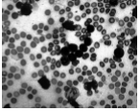
CDFmin = 1
m*n = 6*6=36 L-1=255
m*n – CDFmin= 36 -1 =35
H(15) = ROUND((1 - 1 ) / 35 * 255 ) = 0
H(16) = ROUND((2 - 1 ) / 35 * 255 ) = 7
H(21) = ROUND((3 - 1 ) / 35 * 255 ) = 15
H(23) = ROUND((4 - 1 ) / 35 * 255 ) = 22
H(31) = ROUND((7 - 1 ) / 35 * 255 ) = 44
H(33) = ROUND((8 - 1 ) / 35 * 255 ) = 51
H(34) = ROUND((10 - 1 ) / 35 * 255 ) = 66
H(37) = ROUND((13 - 1 ) / 35 * 255 ) = 87
H(40) = ROUND((14 - 1 ) / 35 * 255 ) = 95
.
.
.
H(75) = ROUND((29 - 1 ) / 35 * 255 ) = 204
H(78) = ROUND((30 - 1 ) / 35 * 255 ) = 211
H(82) = ROUND((31 - 1 ) / 35 * 255 ) = 219
H(85) = ROUND((34 - 1 ) / 35 * 255 ) = 240
H(112) = ROUND((35 - 1 ) / 35 * 255 ) = 248
H(130) = ROUND((36 - 1 ) / 35 * 255 ) = 255
After Histogram Equalization, the result is:
197 | 153 | 248 | 211 | 248 | 248
15 | 248 | 204 | 138 | 109 | 175
255 | 168 | 219 | 36 | 95 | 102
197 | 153 | 182 | 66 | 73 | 44
22 | 138 | 138 | 87 | 0 | 66
160 | 36 | 138 | 51 | 7 | 87
Before Histogram equalization
After Histogram equalization

Slide 20
4. Contrast Stretching
Contrast stretching (often called normalization) is a simple image enhancement technique that attempts to improve the contrast in an image by `stretching' the range of intensity values it contains to span a desired range of values, e.g. the full range of pixel values that the image type concerned allows.
Local contrast value for a particular pixel can be found using the following formula:
I_{output}(x,y)=255*(I_{input}(x,y)-min)/(max-min)
      Ioutput(x,y) is the intensity level for the output pixel
      Iinput(x,y) is the intensity level for the input pixel
      max is the maximum value for intensity level in the input image
      min is the minimum value for intensity level in the input image

Slide 21
Given a grayscale matrix
Applying Contrast Stretching
max=130 min=15
I_{output}(0,0)=255*(I_{input}(0,0)-min)/(max-min)
=255*(69-15)/(130-15) =120
I_{output}(0,1)=255*(I_{input}(0,1)-min)/(max-min)
=255*(59-15)/(130-15)=98
I_{output}(0,2)=255*(I_{input}(0,2)-min)/(max-min)
=255*(85-15)/(130-15)=155
I_{output}(0,3)=255*(I_{input}(0,3)-min)/(max-min)
=255*(78-15)/(130-15)=140
I_{output}(0,4)=255*(I_{input}(0,4)-min)/(max-min)
=255*(112-15)/(130-15) =215
.
.
.
=255*(33-15)/(130-15)=40
I_{output}(5,4)=255*(I_{input}(5,4)-min)/(max-min)
=255*(16-15)/(130-15)=2
I_{output}(5,5)=255*(I_{input}(5,5)-min)/(max-min)
=255*(61-15)/ (130-15)=102
69 | 69 | 85 | 78 | 112 | 85
21 | 85 | 75 | 58 | 53 | 67
130 | 66 | 82 | 24 | 40 | 42
69 | 59 | 68 | 34 | 36 | 31
23 | 58 | 58 | 37 | 15 | 34
61 | 24 | 58 | 33 | 16 | 37

Slide 22
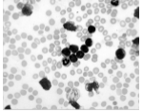
The new matrix obtained after contrast stretching
120 | 98 | 155 | 140 | 215 | 155
13 | 155 | 133 | 95 | 84 | 115
255 | 113 | 149 | 20 | 55 | 60
120 | 98 | 118 | 42 | 47 | 35
18 | 95 | 95 | 49 | 0 | 42
102 | 20 | 95 | 40 | 2 | 49
Before contrast stretching
After contrast stretching

Slide 23
5. Perform Image Arithmetic I1=B+A
Image arithmetic applies one of the standard arithmetic operations or a logical operator to two or more images.
The operators are applied in a pixel-by-pixel fashion which means that the value of a pixel in the output image depends only on the values of the corresponding pixels in the input images.
A main advantage of arithmetic operators is that the process is very simple and therefore fast.
First the Histogram Equalized Image (A) and Contrast Stretched Image (B) is added to obtain the image I1 (B+A) to brighten all other image components except cell nucleus.

Slide 24
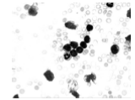
I1 = B + A
120 | 98 | 155 | 140 | 215 | 155
13 | 155 | 133 | 95 | 84 | 115
255 | 113 | 149 | 20 | 55 | 60
120 | 98 | 118 | 42 | 47 | 35
18 | 95 | 95 | 49 | 0 | 42
102 | 20 | 95 | 40 | 2 | 49
197 | 153 | 248 | 211 | 248 | 248
15 | 248 | 204 | 138 | 109 | 175
255 | 168 | 219 | 36 | 95 | 102
197 | 153 | 82 | 66 | 73 | 44
22 | 138 | 138 | 87 | 0 | 66
160 | 36 | 138 | 51 | 7 | 87
Result, I1
­­I1 =
317 | 251 | 403 | 351 | 463 | 403
28 | 403 | 333 | 233 | 193 | 290
510 | 281 | 368 | 56 | 150 | 162
317 | 251 | 300 | 108 | 120 | 79
40 | 233 | 233 | 163 | 0 | 108
262 | 56 | 233 | 91 | 9 | 136
255 | 251 | 255 | 255 | 255 | 255
28 | 255 | 255 | 233 | 193 | 255
255 | 255 | 255 | 56 | 150 | 162
255 | 251 | 255 | 108 | 120 | 79
40 | 233 | 233 | 136 | 0 | 108
255 | 56 | 233 | 91 | 9 | 136
Truncation

Slide 25
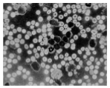
6. Perform Image Arithmetic I2=I1-A
Image I2 (I1-A) is obtained to highlight the entire image objects along with cell nucleus.
I2 = I1 - A
I2
255 | 251 | 255 | 255 | 255 | 255
28 | 255 | 255 | 233 | 193 | 255
255 | 255 | 255 | 56 | 150 | 162
255 | 251 | 255 | 108 | 120 | 79
40 | 233 | 233 | 136 | 0 | 108
255 | 56 | 233 | 91 | 9 | 136
197 | 153 | 248 | 211 | 248 | 248
15 | 248 | 204 | 138 | 109 | 175
255 | 168 | 219 | 36 | 95 | 102
197 | 153 | 82 | 66 | 73 | 44
22 | 138 | 138 | 87 | 0 | 66
160 | 36 | 138 | 51 | 7 | 87
58 | 98 | 7 | 44 | 7 | 7
13 | 7 | 51 | 95 | 84 | 80
0 | 87 | 36 | 20 | 55 | 60
58 | 98 | 73 | 42 | 47 | 35
18 | 95 | 95 | 49 | 0 | 42
95 | 20 | 95 | 40 | 2 | 49
Result, Image I2

Slide 26
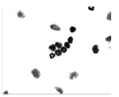
7. Perform Image Arithmetic I3=I1+I2
Obtain the image I3 (I1+I2) to remove all other components of blood with minimum effect of distortion over nucleus.
I3 = I1 + I2
255 | 251 | 255 | 255 | 255 | 255
28 | 255 | 255 | 233 | 193 | 255
255 | 255 | 255 | 56 | 150 | 162
255 | 251 | 255 | 108 | 120 | 79
40 | 233 | 233 | 136 | 0 | 108
255 | 56 | 233 | 91 | 9 | 136
58 | 98 | 7 | 44 | 7 | 7
13 | 7 | 51 | 95 | 84 | 80
0 | 87 | 36 | 20 | 55 | 60
58 | 98 | 73 | 42 | 47 | 35
18 | 95 | 95 | 49 | 0 | 42
95 | 20 | 95 | 40 | 2 | 49
Result, Image I3
I3=
313 | 349 | 262 | 299 | 262 | 262
41 | 262 | 306 | 328 | 277 | 335
255 | 342 | 291 | 76 | 205 | 222
313 | 349 | 328 | 150 | 167 | 114
58 | 328 | 328 | 185 | 0 | 150
350 | 76 | 328 | 131 | 11 | 185
255 | 255 | 255 | 255 | 255 | 255
41 | 255 | 255 | 255 | 255 | 255
255 | 255 | 255 | 76 | 205 | 222
255 | 255 | 255 | 150 | 167 | 114
58 | 255 | 255 | 185 | 0 | 150
255 | 76 | 255 | 131 | 11 | 185
Truncation

Slide 27
8. Median Filtering
The median filter is a nonlinear digital filtering technique, often used to remove noise from an image or signal.
Such noise reduction is a typical pre-processing step to improve the results of later processing.
The noise that could be present in the image of the dataset is salt-and-pepper noise. In order to remove this noise and increase the darkness of the nuclei, Median Filter technique is used.
Algorithm for Median Filter
  Consider each pixel in the image
  Sort the neighboring pixels into order based upon their intensities
  Replace the original value of the pixel with the median value from the list

Slide 28
Consider a 4x4 image having the following pixel values
Replacing the mid element of the 3x3 matrix with the middle value from the above sorted list (i.e. pixel value = 9). So, the corresponding output is:
8 | 9 | 10 | 11
1 | 8 | 9 | 10
12 | 13 | 8 | 9
11 | 12 | 13 | 8
8 | 9 | 10 | 11
1 | 9 | 9 | 10
12 | 13 | 8 | 9
11 | 12 | 13 | 8
Let the structuring element be 3x3 matrix:
Iteration 2:
8 | 9 | 10 | 11
1 | 8 | 9 | 10
12 | 13 | 8 | 9
11 | 12 | 13 | 8
Iteration 1
Traversing from left to right
Arranging the pixel values in ascending order:
8 9 9 9 9 10 10 11 13
Replacing the mid element of the 3x3 matrix with the middle value from the above sorted list (i.e. pixel value=9). So, the corresponding output is:
8 | 9 | 10 | 11
1 | 8 | 9 | 10
12 | 13 | 8 | 9
11 | 12 | 13 | 8
Arranging the pixel values in ascending order:
8 8 8 9 9 10 12 13 13

Slide 29
.
.
.
Iteration 7:
8 | 9 | 10 | 11
1 | 9 | 9 | 10
12 | 13 | 8 | 9
11 | 12 | 13 | 8
 | 9 | 10 | 11
9 | 9 | 10 | 11
13 | 9 | 9 | 10
12 | 12 | 9 | 9
11 | 12 | 13 | 8
Iteration 3:
8 | 9 | 10 | 11
1 | 9 | 9 | 10
12 | 13 | 8 | 9
11 | 12 | 13 | 8
So the corresponding output is:
9 | 9 | 10 | 11
13 | 9 | 9 | 10
12 | 12 | 9 | 9
11 | 12 | 13 | 8
Arranging the pixel values in ascending order:
8 9 9 11 12 12 13 13 13
Replacing the mid element of the 3X3 matrix with the middle value from the above sorted list (i.e. pixel value=12). So, the corresponding output is:
Hence, after 16 iterations, we get:
9 | 9 | 10 | 10
12 | 9 | 9 | 10
12 | 12 | 9 | 9
12 | 12 | 12 | 9
8 | 9 | 10 | 11
1 | 9 | 9 | 10
12 | 12 | 8 | 9
11 | 12 | 13 | 8

Slide 30
9. Segmentation using k-Means Algorithm
Image Segmentation can be defined as the partition or segmentation of a digital image into similar regions with the main aim to simplify the image under consideration into something more meaningful and easier to analyze.
To achieve this, the resulting image is converted into a binary image. In binary images, the pixels assume a value of 0 or 1.
The binary image is created from a grayscale image using a threshold process.
Binary images are often used in representing basic shapes and line drawings.

Slide 31
K-Means Algorithm
Input: Samples of grayscale image, a sample K
Output: Set of K clusters
Step 1: Pick a number of clusters centroid (k).
Step 2: Assign every item to its nearest cluster center using Euclidean Distance formula.
Step 3: Move each cluster centroid to the mean of its assigned items.
Step 4: Repeat steps 2,3 until convergence (change in cluster assignments less than a threshold or if the mean remains constant).

Slide 32
Consider the image to have the following grayscale values: 69,59,85,78,21,85,75,58,130,66,82,24,69,59
Let the two chosen clusters be 21 and 130
Finding the Euclidian distance:
Gray value = 69
k=21 Dist[1]= sqrt(pow(21-69,2)) = 48
k=130 Dist[1]= sqrt(pow(130-69,2)) = 61
Gray value = 59
k=21 Dist[2]= sqrt(pow(21-59,2)) = 38
k=130 Dist[2]= sqrt(pow(130-59,2)) = 71
Gray value = 85
k=21 Dist[3]= sqrt(pow(21-85,2)) = 64
k=130 Dist[3]= sqrt(pow(130-85,2)) = 45
Gray value = 78
k=21 Dist[4]= sqrt(pow(21-78,2)) = 57
k=130 Dist[4]= sqrt(pow(130-78,2)) = 52
Gray value = 21
k=21 Dist[5]= sqrt(pow(21-21,2)) = 0
k=130 Dist[5]= sqrt(pow(130-21,2)) = 109
Gray value = 85
k=21 Dist[6]= sqrt(pow(21-85,2)) = 64
k=130 Dist[6]= sqrt(pow(130-85,2)) = 45
Gray value = 75
k=21 Dist[7]= sqrt(pow(21-75,2)) = 54
k=130 Dist[7]= sqrt(pow(130-75,2)) = 55
Gray value = 58
k=21 Dist[8]= sqrt(pow(21-58,2)) = 37
k=130 Dist[8]= sqrt(pow(130-58,2)) = 72
Gray value = 130
k=21 Dist[9]= sqrt(pow(21-130,2)) = 109
k=130 Dist[9]= sqrt(pow(130-130,2)) = 0
Gray value = 66
k=21 Dist[10]= sqrt(pow(21-66,2)) = 45
k=130 Dist[10]= sqrt(pow(130-66,2)) = 64
Gray value = 82
k=21 Dist[11]= sqrt(pow(21-82,2)) = 61
k=130 Dist[11]= sqrt(pow(130-82,2)) = 48

Slide 33
Gray value = 24
k=21 Dist[12]= sqrt(pow(21-24,2)) = 3
k=130 Dist[12]= sqrt(pow(130-24,2)) = 106
Gray value = 69
k=21 Dist[13]= sqrt(pow(21-69,2)) = 48
k=130 Dist[13]= sqrt(pow(130-69,2)) = 61
Gray value = 59
k=21 Dist[14]= sqrt(pow(21-59,2)) = 38
k=130 Dist[14]= sqrt(pow(130-59,2)) = 71
Pixel | Gray Values | Cluster I (21) | Cluster II (130)
1 | 69 | 48 | 61
2 | 59 | 38 | 71
3 | 85 | 64 | 45
4 | 78 | 57 | 52
5 | 21 | 0 | 109
6 | 85 | 64 | 45
7 | 75 | 54 | 55
8 | 58 | 37 | 72
9 | 130 | 109 | 0
10 | 66 | 45 | 64
11 | 82 | 61 | 48
12 | 24 | 3 | 106
13 | 69 | 48 | 61
14 | 59 | 38 | 71
Putting the pixels into clusters and calculating their mean, we get:
Cluster | Pixels | Mean
Cluster 1 | 1,2,5,7,8,10,12,13,14 | 55.55
Cluster 2 | 3,4,6,9,11 | 92

Slide 34
Calculating the Euclidian distances with the new centers 55.55 and 92, we get:
Pixel | Gray Values | Cluster I (55.55) | Cluster II (92)
1 | 69 | 13.45 | 23
2 | 59 | 3.45 | 33
3 | 85 | 29.45 | 7
4 | 78 | 22.45 | 14
5 | 21 | 34.55 | 71
6 | 85 | 29.45 | 7
7 | 75 | 19.45 | 17
8 | 58 | 2.45 | 34
9 | 130 | 74.45 | 38
10 | 66 | 10.45 | 26
11 | 82 | 26.45 | 10
12 | 24 | 31.55 | 68
13 | 69 | 13.45 | 23
14 | 59 | 3.45 | 33
Putting the pixels into clusters and calculating their mean, we get:
Cluster | Pixels | Mean
Cluster I | 1,2,5,7,8,10,12,13,14 | 55.55
Cluster II | 3,4,6,9,11 | 92

Slide 35
Advantages of k-Means Clustering:
Efficient, and scales well.
Performs well on normally distributed data.
Useful when the number of samples is large
Ideal when not too many clusters are to be formed and distance can be measured in a linear fashion.
Disadvantages of k-Mean Clustering:
With fewer samples of data, initial grouping will determine the cluster significantly.
The number of clusters K must be determined beforehand.
With fewer samples incorrect clustering can occur.
We never know which variable contributes more to the clustering process since we assume that each of them has same weight.
The accuracy of mathematical averaging weakens because of outliers, which may pull the centroid away from its true position.

Slide 36
10. Morphological Opening
Morphology is the study of shapes.
Mathematical morphology is a tool for extracting geometric information from binary and grayscale images.
The word morphology means the form and structure of the object.
Erosion and dilation are the morphological operations, which describe the interaction with structuring element S.
Shape, used to probe or interact with a given image, with the purpose of drawing conclusions on how this shape fits or misses the shapes in the image.
There are two main characteristics that are directly related to structuring elements:
  Shape. For example, the structuring element can be a "ball" or a line; convex or a ring, etc. By choosing a particular structuring element, one sets a way of differentiating some objects (or parts of objects) from others, according to their shape or spatial orientation.
  Size: For example, one structuring element can be a 3x3 square or a 21x21 square.

Slide 37
Erosion - Let E be a Euclidean space or an integer grid, and A a binary image in E. The erosion of the binary image A by the structuring element B is defined by:
where B_{z} is the translation of B by the vector z. Erosion generally decreases the size of objects and removes small anomalies by subtracting objects smaller than the structuring element.
Dilation - The dilation can be obtained by:
where B^{s} denotes the symmetric of B. Dilation generally increases the size of objects by filling in holes and broken areas and connecting areas that are separated by spaces smaller than the structuring element.
Erosion operation removes objects that are smaller than structuring element B and dilation operation restores the shape of remaining objects.

Slide 38

Opening - the dilation of the erosion of a set A by a structuring element B:
Opening is carried out to remove small pixel groups
Consider a binary image with the following values for opening:
Let the structuring element be:
0 | 0 | 1 | 1
0 | 1 | 1 | 1
0 | 1 | 1 | 1
1 | 1 | 1 | 1

Slide 39
Erosion
Iteration 1
Iteration 2
Iteration 3
 | 0 | 0 | 1 | 1
 | 0 | 1 | 1 | 1
 | 0 | 1 | 1 | 1
 | 1 | 1 | 1 | 1
0 | 0 | 1 | 1
0 | 1 | 1 | 1
0 | 1 | 1 | 1
1 | 1 | 1 | 1
0 | 0 | 1 | 1
0 | 1 | 1 | 1
0 | 1 | 1 | 1
1 | 1 | 1 | 1
So the corresponding output is:
So the corresponding output is:
So the corresponding output is:
0
0 | 0
0 | 0 | 0

Slide 40
Iteration 7
After 16 iterations we get the eroded binary image:
0 | 0 | 1 | 1
0 | 1 | 1 | 1
0 | 1 | 1 | 1
1 | 1 | 1 | 1
0 | 0 | 0 | 0
0 | 0 | 1 | 0
0 | 0 | 1 | 0
0 | 0 | 0 | 0
. . .
So the corresponding output is:
. . .
0 | 0 | 0 | 0
0 | 0 | 1

Slide 41
Dilation
Input: Result of erosion
Structuring element used is the same.
Iteration 1
Iteration 2
Iteration 3
 | 0 | 0 | 0 | 0
 | 0 | 0 | 1 | 0
 | 0 | 0 | 1 | 0
 | 0 | 0 | 0 | 0
0 | 0 | 0 | 0
0 | 0 | 1 | 0
0 | 0 | 1 | 0
0 | 0 | 0 | 0
0 | 0 | 0 | 0
0 | 0 | 1 | 0
0 | 0 | 1 | 0
0 | 0 | 0 | 0
So the corresponding output is:
So the corresponding output is:
So the corresponding output is:
0
0 | 0
0 | 0 | 1

Slide 42
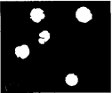
Iteration 7
After 16 iterations we get the dilated binary image:
0 | 0 | 0 | 0
0 | 0 | 1 | 0
0 | 0 | 1 | 0
0 | 0 | 0 | 0
0 | 0 | 1 | 0
0 | 1 | 1 | 1
0 | 1 | 1 | 1
0 | 0 | 1 | 0
. . .
So the corresponding output is:
. . .
0 | 0 | 1 | 0
0 | 1 | 1
Resultant Binary Image

Slide 43
FEATURE EXTRACTION

Slide 44
Feature Extraction
Feature extraction a type of dimensionality reduction that efficiently represents interesting parts of an image as a compact feature vector.
Transforming the input data into the set of features is called feature extraction.
In order to construct an effective feature set, several research papers were studied and their features studied were noted.
It was noticed that the following features widely used as they gave a good classification:
  Area
  Perimeter
  Compactness
  Standard deviation
  Variance
  Energy
  Entropy

Slide 45
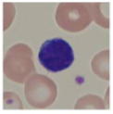
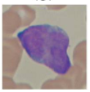
1. Area
The most important feature to predict if the cell is a blast cell or not is the area.
To find the area, we need to extract the individual cell regions from the binary image created in the pre-processing phase.
The area can be computed by counting the number of non-zero pixels of each component extracted.
Healthy Cell from non-ALL patient
Lymphoblast from ALL patient

Slide 46
Consider the following binary image matrix
To find the area, we need to extract the individual cell regions from the binary image created in the pre-processing phase.
The area can be computed by counting the number of non-zero pixels of each component extracted.
SAGAP algorithm is used to extract connected components from the binary image.
 |  |  |  |  | (2,6)
 |  |  |  |  | (3,6) | (3,7)
 |  | (4,3)
 |  | (5,3) | (5,4)
 |  |  | (6,4)

Slide 47
Vertically scan each pixel
 |  |  |  |  | (2,6)
 |  |  |  |  | (3,6) | (3,7)
 |  | (4,3)
 |  | (5,3) | (5,4)
 |  |  | (6,4)
Connected component-1
consists of white pixels at (4, 3), (5, 3), (4, 4) (5,4),(6,4)and(5,5) co-ordinates. Connected component-2
consists of white pixels at (2, 6), (3, 6) and (3, 7) co-ordinates.

Slide 48
Generation of tree
While scanning we hit the first white pixel at coordinate (4, 3). So we create a node and store the corresponding row and column value i.e. 4 and 3. we name this node as the root node.
Root
4,3
null
null

Slide 49
We then find all 8-neighbours of the pixel(4,3)
Root
4,3
null
 |  |  |  |  | (2,6)
 |  |  |  |  | (3,6) | (3,7)
 |  | (4,3)
 |  | (5,3) | (5,4)
 |  |  | (6,4)
5,3
5,4
null

Slide 50
Continue scanning and on hitting the second white pixel (5, 3). Similarly we create a node for this pixel and link all the neighborhood pixels with the pixel (5, 3)
Root
 |  |  |  |  | (2,6)
 |  |  |  |  | (3,6) | (3,7)
 |  | (4,3)
 |  | (5,3) | (5,4)
 |  |  | (6,4)
4,3
5,3
null
5,3
4,3
5,4
5,4
null
6,4
null

Slide 51
Similarly we create nodes for every white pixel, link them with their neighborhood pixels and link them with each other.
Top nodes
Current
Next of current
4,3
5,3
5,4
6,4
2,6
3,6
3,7
Bottom of current
5,3
4,3
5,3
5,3
3,6
2,6
2,6
Bottom
nodes
5,4
5,4
6,4
5,4
3,7
3,7
3,6
null
null
null
null
null
null
6,4
null
Let Root node be Current, The node to the right of Current is Next of Current. The node below Current as Bottom of Current.

Slide 52
SAGAP Algorithm
Input: Binary Image
Output : Individual connected components
1. Set Current = Root.
2. Set Bottom = Current. Down.
3. Set Next = Current. Right.
4. Do If (Bottom.row = Next.row) AND (Bottom.col = Next.col)
a. Set Temp = Next. Set Next = Next. Down. Set Current. Right= Next. Set Next. Right=Temp.Right. Delete node Temp.
b. Compare all nodes of Current with all nodes of Next.
c. If (matched)
d. Delete the duplicate node from Next and link accordingly.
e. Join the remaining nodes (unmatched) of Next with Bottom and Set Current. Right=Next. Right. Else Set Next=Next. Right.
5. Set Bottom=Bottom. Down. Set Next = Current. Right.
6. Repeat Step 3 and Step 4 till Bottom reaches to Null.
7. Set Current=Current.Right. Set Bottom=Current. Down. Set Next=Current. Right.
8. Repeat from Step 3 to Step 6 until Next reaches to Null
Algorithm

Slide 53
Top nodes
Current
Next of current
4,3
5,3
5,4
6,4
2,6
3,6
3,7
Bottom of current
5,3
4,3
5,3
5,3
3,6
2,6
2,6
Bottom
nodes
5,4
5,4
6,4
5,4
3,7
3,7
3,6
null
null
null
null
null
null
6,4
null
Compare Bottom with Next of Current, Since they are the same, delete the node in Next of Current and link accordingly.

Slide 54
Now, compare the nodes in Current with all then nodes in Next of Current.
If match occurs then, delete node from Next of Current, link accordingly and move to next node in Current.
Top nodes
Current
Next of current
4,3
4,3
5,4
6,4
2,6
3,6
3,7
Bottom of current
5,3
5,4
5,3
5,3
3,6
2,6
2,6
Bottom
nodes
5,4
6,4
6,4
5,4
3,7
3,7
3,6
null
null
null
null
null
null
null
Matches, therefore delete node in Next of Current, link nodes and move to Bottom of Current.

Slide 55
Top nodes
Current
Next of current
4,3
5,4
5,4
6,4
2,6
3,6
3,7
Bottom of current
5,3
6,4
5,3
5,3
3,6
2,6
2,6
Bottom
nodes
5,4
null
6,4
5,4
3,7
3,7
3,6
null
null
null
null
null
null
Does not match, therefore compare with next node in Next of Current.

Slide 56
Top nodes
Current
Next of current
4,3
5,4
5,4
6,4
2,6
3,6
3,7
Bottom of current
5,3
6,4
5,3
5,3
3,6
2,6
2,6
Bottom
nodes
5,4
null
6,4
5,4
3,7
3,7
3,6
null
null
null
null
null
null
Does not match, since node in Next of Current is the last node. We compare next node in Current with all nodes in Next of Current.

Slide 57
Top nodes
Current
Next of current
4,3
5,4
5,4
6,4
2,6
3,6
3,7
Bottom of current
5,3
6,4
5,3
5,3
3,6
2,6
2,6
Bottom
nodes
5,4
null
6,4
5,4
3,7
3,7
3,6
null
null
null
null
null
null
Matches, therefore delete Next of Current and link accordingly.

Slide 58
Top nodes
Current
Next of current
4,3
6,4
5,4
6,4
2,6
3,6
3,7
Bottom of current
5,3
null
5,3
5,3
3,6
2,6
2,6
Bottom
nodes
5,4
6,4
5,4
3,7
3,7
3,6
null
null
null
null
null
null
Does not match. Since node in Current is the last node, merge Current and Next of Current and link accordingly.

Slide 59
Set Bottom of Current to node below it.
Top nodes
Current
Next of current
4,3
5,4
6,4
2,6
3,6
3,7
5,3
5,3
5,3
3,6
2,6
2,6
Bottom
nodes
Bottom of current
5,4
6,4
5,4
3,7
3,7
3,6
null
null
null
6,4
null
null
null
Compare Bottom with Next of Current, Since they are the same, delete the node in Next of Current and link accordingly.

Slide 60
Now, compare the nodes in Current with all then nodes in Next of Current.
If match occurs then, delete node from Next of Current, link accordingly and move to next node in Current.
Top nodes
Current
Next of current
4,3
5,3
6,4
2,6
3,6
3,7
5,3
5,3
3,6
2,6
2,6
6,4
Bottom
nodes
Bottom of current
5,4
null
5,4
3,7
3,7
3,6
null
null
null
6,4
null
null
Does not Match, compare with the next node in Next of current.

Slide 61
Top nodes
Current
Next of current
4,3
5,3
6,4
2,6
3,6
3,7
5,3
5,3
3,6
2,6
2,6
6,4
Bottom
nodes
Bottom of current
5,4
null
5,4
3,7
3,7
3,6
null
null
null
6,4
null
null
Does not Match, compare next node in Current with the next node in Next of current.

Slide 62
Top nodes
Current
Next of current
4,3
5,3
6,4
2,6
3,6
3,7
5,3
5,3
3,6
2,6
2,6
6,4
Bottom
nodes
Bottom of current
5,4
null
5,4
3,7
3,7
3,6
null
null
null
6,4
null
null
Matches, therefore delete Next of Current and link accordingly. Move to next node in Current

Slide 63
Top nodes
Current
Next of current
4,3
6,4
6,4
2,6
3,6
3,7
5,3
null
5,3
3,6
2,6
2,6
Bottom
nodes
Bottom of current
5,4
5,4
3,7
3,7
3,6
null
null
null
6,4
null
null
Does not match, since node in Next of Current is the last node. We compare next node in Current with all nodes in Next of Current.

Slide 64
Top nodes
Current
Next of current
4,3
6,4
6,4
2,6
3,6
3,7
5,3
null
5,3
3,6
2,6
2,6
Bottom
nodes
Bottom of current
5,4
5,4
3,7
3,7
3,6
null
null
null
6,4
null
null
Matches, therefore delete Next of Current and link accordingly.

Slide 65
Top nodes
Current
Next of current
4,3
6,4
2,6
3,6
3,7
5,3
5,3
3,6
2,6
2,6
Bottom
nodes
5,4
5,4
3,7
3,7
3,6
Bottom of current
null
null
null
6,4
null
null
null
Matches, therefore delete Next of Current and link accordingly.

Slide 66
Top nodes
Current
Next of current
4,3
5,3
2,6
3,6
3,7
5,3
5,4
3,6
2,6
2,6
Bottom
nodes
null
5,4
3,7
3,7
3,6
Bottom of current
null
null
6,4
null
null
null
Does not Match, therefore compare with the next element in next of current.

Slide 67
Top nodes
Current
Next of current
4,3
5,3
2,6
3,6
3,7
5,3
5,4
3,6
2,6
2,6
Bottom
nodes
null
5,4
3,7
3,7
3,6
Bottom of current
null
null
6,4
null
null
null
Does not Match, since the last element in next of current we move to next element in current.

Slide 68
Top nodes
Current
Next of current
4,3
5,3
2,6
3,6
3,7
5,3
5,4
3,6
2,6
2,6
Bottom
nodes
null
5,4
3,7
3,7
3,6
Bottom of current
null
null
6,4
null
null
null
Matches, therefore remove the node from next of current and link accordingly.

Slide 69
Top nodes
Current
Next of current
4,3
5,4
2,6
3,6
3,7
5,3
null
3,6
2,6
2,6
Bottom
nodes
5,4
3,7
3,7
3,6
Bottom of current
null
null
6,4
null
null
null
Matches, therefore remove the node from next of current and link accordingly.

Slide 70
Top nodes
Current
Next of current
4,3
5,4
2,6
3,6
3,7
5,3
null
3,6
2,6
2,6
Bottom
nodes
5,4
3,7
3,7
3,6
Bottom of current
null
null
6,4
null
null
null
Matches, therefore remove the node from next of current and link accordingly.

Slide 71
Similarly
Current
Next of current
4,3
2,6
3,6
3,7
5,3
Bottom of current
3,6
2,6
2,6
Bottom
nodes
5,4
3,7
3,7
3,6
null
null
6,4
null
null
Now, compare Bottom of Current with Next of Current.

Slide 72
Current
Next of current
4,3
2,6
3,6
3,7
5,3
Bottom of current
3,6
2,6
2,6
Bottom
nodes
5,4
3,7
3,7
3,6
null
null
6,4
null
null
Matches, therefore delete Next of Current and link accordingly.

Slide 73
Now, compare the nodes in Current with all then nodes in Next of Current.
If match occurs then, delete node from Next of Current, link accordingly and move to next node in Current.
Current
Next of current
4,3
2,6
2,6
3,7
5,3
Bottom of current
3,6
3,7
2,6
Bottom
nodes
null
5,4
3,7
3,6
null
6,4
null
null
Matches, therefore delete Next of Current and link accordingly.

Slide 74
Current
Next of current
4,3
2,6
3,7
3,7
Bottom of current
null
2,6
5,3
3,6
Bottom
nodes
5,4
3,7
3,6
null
6,4
null
null
Does not match, since node in Next of Current is the last node. We compare next node in Current with all nodes in Next of Current.

Slide 75
Current
Next of current
4,3
2,6
3,7
3,7
Bottom of current
null
2,6
5,3
3,6
Bottom
nodes
5,4
3,7
3,6
null
6,4
null
null
Matches, therefore delete Next of Current and link accordingly.

Slide 76
Similarly
4,3
2,6
null
5,3
3,6
5,4
3,7
6,4
null
null

Slide 77
To Create Separate Images with new co-ordinate values.
a) Find the minimum row and column values for Current.
b) Find the maximum row and column values for Current
For Object 1
Max_row:6
Max_col:4
Min_row:4
Min_col:3
For Object 2
Max_row:3
Max_col:7
Min_row:2
Min_col:6
Create a 2D matrix of dimension [Max_row – Min_row +1] [Max_col – Min_col +1].

Slide 78
Create a 2D matrix of dimension [Max_row – Min_row +1] [Max_col – Min_col +1]
For given (x,y), new co-ordinate = [x – Min_row +1][y –Min_col + 1]
AREA = No. of white Pixels * 0.264
Where 0.264mm is the size of each pixel
Object 1
Dimension of new Image →[6-4+1][4-3+1] = [3][2]
(4, 3) → (4-4+1, 3-3+1) = (1, 1)
(5, 3) → (5-4+1, 3-3+1) = (2, 1)
(5, 4) → (5-4+1, 4-3+1) = (2, 2)
(6, 4) → (6-4+1, 4-3+1) = (3, 2)
AREA = 4 * 0.264 = 1.056
Object 2
Dimension of new Image →[3-2+1][7-6+1] = [2][2]
(2, 6) → (2-2+1, 6-6+1) → (1, 1)
(3, 6) → (3-2+1, 6-6+1) → (2, 1)
(3, 7) → (3-2+1, 7-6+1) → (2, 2)
AREA = 3 * 0.264 = 0.792

Slide 79
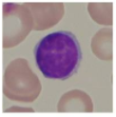
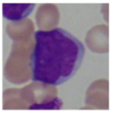
2. Perimeter
Another important feature that needs to be extracted is the perimeter of the nucleus.
The perimeter can be computed by detecting the edges of the nucleus and counting the border pixels.
Healthy Cell from non-ALL patient
Lymphoblast from ALL patient

Slide 80
Edge Detection Using Method of Masks
This method comes directly from the fact that binary operations (AND, OR, and NOT) are the fastest operations on digital computers.
The method is divided into three stages:
  Mask construction
  Fundamental edges generation
  Constructing the edge
The Algorithm will be applied on the Image matrix
Original Image (A)

Slide 81
Mask Construction
The mask we use here is constructed by using the inversion of the image pixels (1s to 0s and vice versa)
Applying inversion to the given image matrix
Original Image (A)
Inverted Image (M)
Inversion

Slide 82
Fundamental edges generation
This is the main step in the method, in this step the masked image is moved one pixel at a time in the fundamental 4 directions (left, right, up, and down) and anded with the original to get a fundamental edge each time.
For example to get the left edge of the image, the mask is shifted to the right one pixel and anded with the original image.

Slide 83
Left Edge of Image
Shift Mask(M) one-pixel right to get MR’
Apply and Operation to A and MR’ to get L.
Mask Shifted to right(MR’)
Original Image(A)
Left Edge (L)
AND

Slide 84
Right Edge of Image
Shift Mask(M) one-pixel left to get ML’
Apply and Operation to A and ML’ to get R.
Mask Shifted to left(ML’)
Original Image(A)
Right Edge (R)
AND

Slide 85
Top Edge of Image
Shift Mask(M) one-pixel down to get MD’
Apply and Operation to A and MD’ to get T.
Mask Shifted down(MD’)
Original Image(A)
Top Edge (T)
AND

Slide 86
Bottom Edge of Image
Shift Mask(M) one-pixel up to get MU’
Apply and Operation to A and MU’ to get B.
Mask Shifted to right(MU’)
Original Image(A)
Bottom Edge (B)
AND

Slide 87
Constructing the edge
The edge of the image can be constructed by simply ORing the four edges that were computed in previous steps.
  I.e. L OR R OR T OR B → Final Constructed edges
Left Edge (L)
Right Edge (R)
Top Edge (T)
Bottom Edge (B)
OR
OR
OR
AND
The perimeter is computed by using the formula:
PERIMETER = No. of horizontal & vertical links + (No. of diagonal links * √2)
PERIMETER = (6 + 6) + (4 * √2) = 17.6568
RESULT

Slide 88
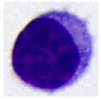
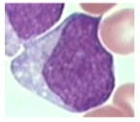
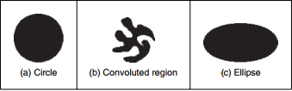

3. Compactness
  Compactness measures the ratio between the area of the shape and the circle that can be traced with the same perimeter.
  Compactness $=\frac{\text{4 ∗ }π\text{ ∗ }\text{Area}}{\text{Perimeter}2}$
  For Circular Region Compactness ≈ 1
  Low values of compactness are associated with less compact regions and also with simple though highly elongated shapes.
Healthy Cell from non-ALL patient
Lymphoblast from ALL patient

Slide 89
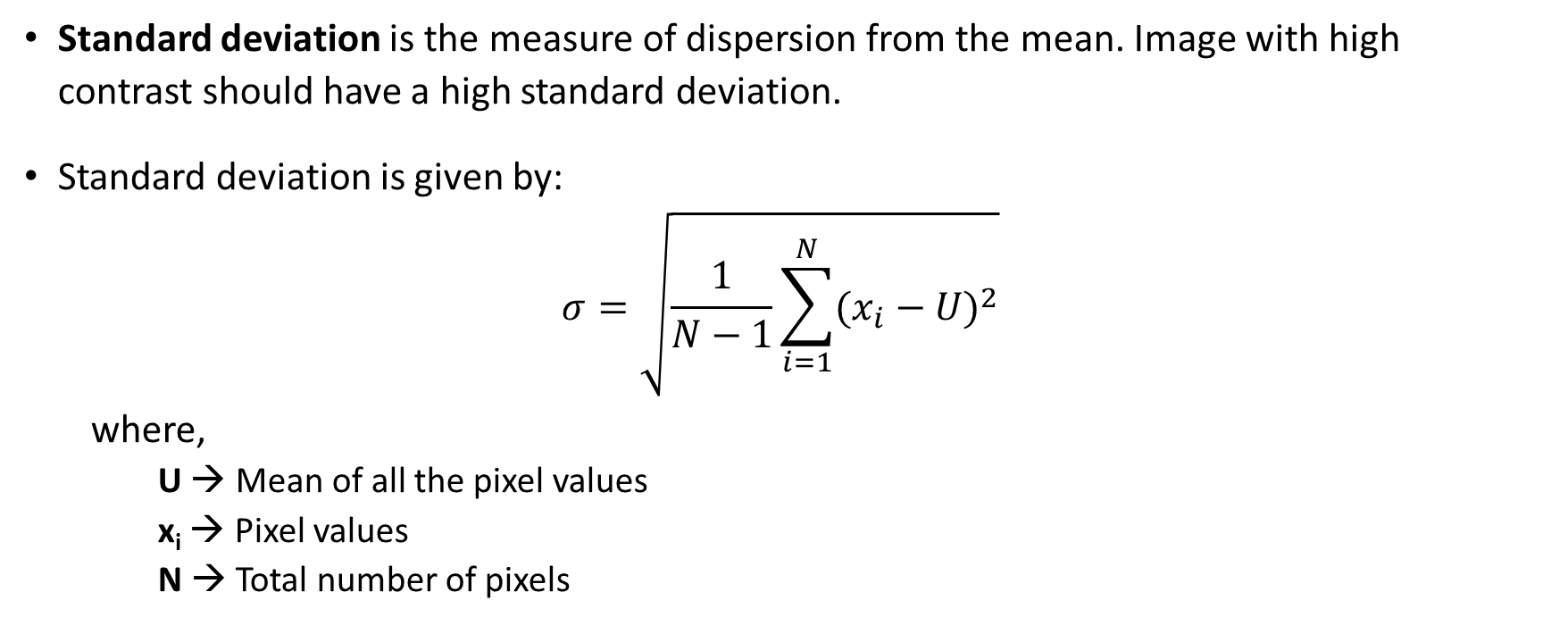
4. Standard Deviation
Standard deviation is the measure of dispersion from the mean. Image with high contrast should have a high standard deviation.
Standard deviation is given by:
$$σ=\sqrt{\frac{1}{N−1}\sum_{i=1}^{N}{{(x_{i}−U)}^{2}}}$$
where,
  U → Mean of all the pixel values
  x_{i} → Pixel values
  N → Total number of pixels

Slide 90
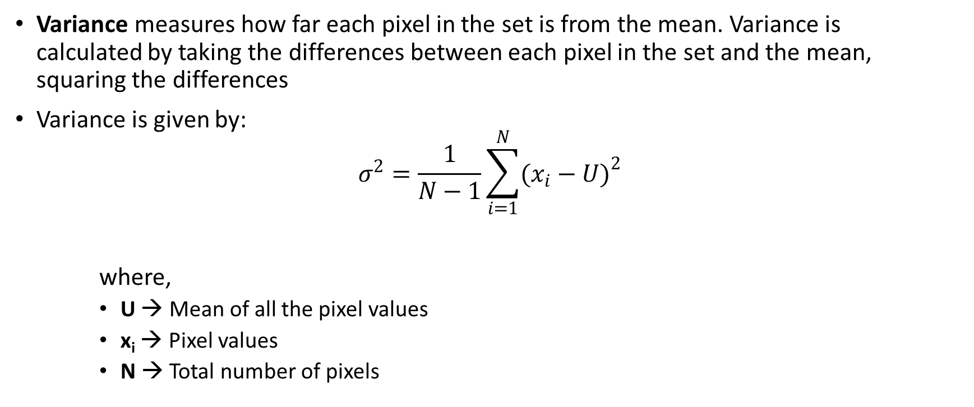
5. Variance
Variance measures how far each pixel in the set is from the mean. Variance is calculated by taking the differences between each pixel in the set and the mean, squaring the differences
Variance is given by:
$$σ^{2}=\frac{1}{N−1}\sum_{i=1}^{N}{{(x_{i}−U)}^{2}}$$
where,
    U → Mean of all the pixel values
    x_{i} → Pixel values
    N → Total number of pixels

Slide 91
Mathematical model for standard deviation and variance
The following matrix will be considered for computing standard deviation and variance.
10 | 30 | 40 | 80 | 20 | 15
22 | 36 | 11 | 14 | 18 | 45
31 | 150 | 115 | 100 | 200 | 180
40 | 175 | 225 | 115 | 30 | 10
50 | 117 | 222 | 116 | 40 | 20
22 | 165 | 122 | 117 | 50 | 30
Mathematical model

Slide 92
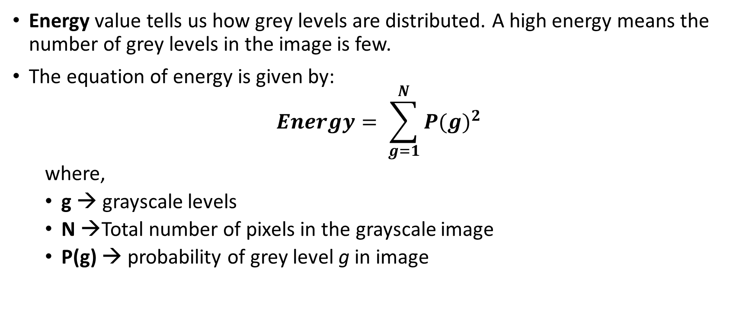
6. Energy
Energy value tells us how grey levels are distributed. A high energy means the number of grey levels in the image is few.
The equation of energy is given by:
$$Energy= \sum_{g=1}^{N}{{P(g)}^{2}}$$
  where,
  g → grayscale levels
  N →Total number of pixels in the grayscale image
  P(g) → probability of grey level g in image

Slide 93
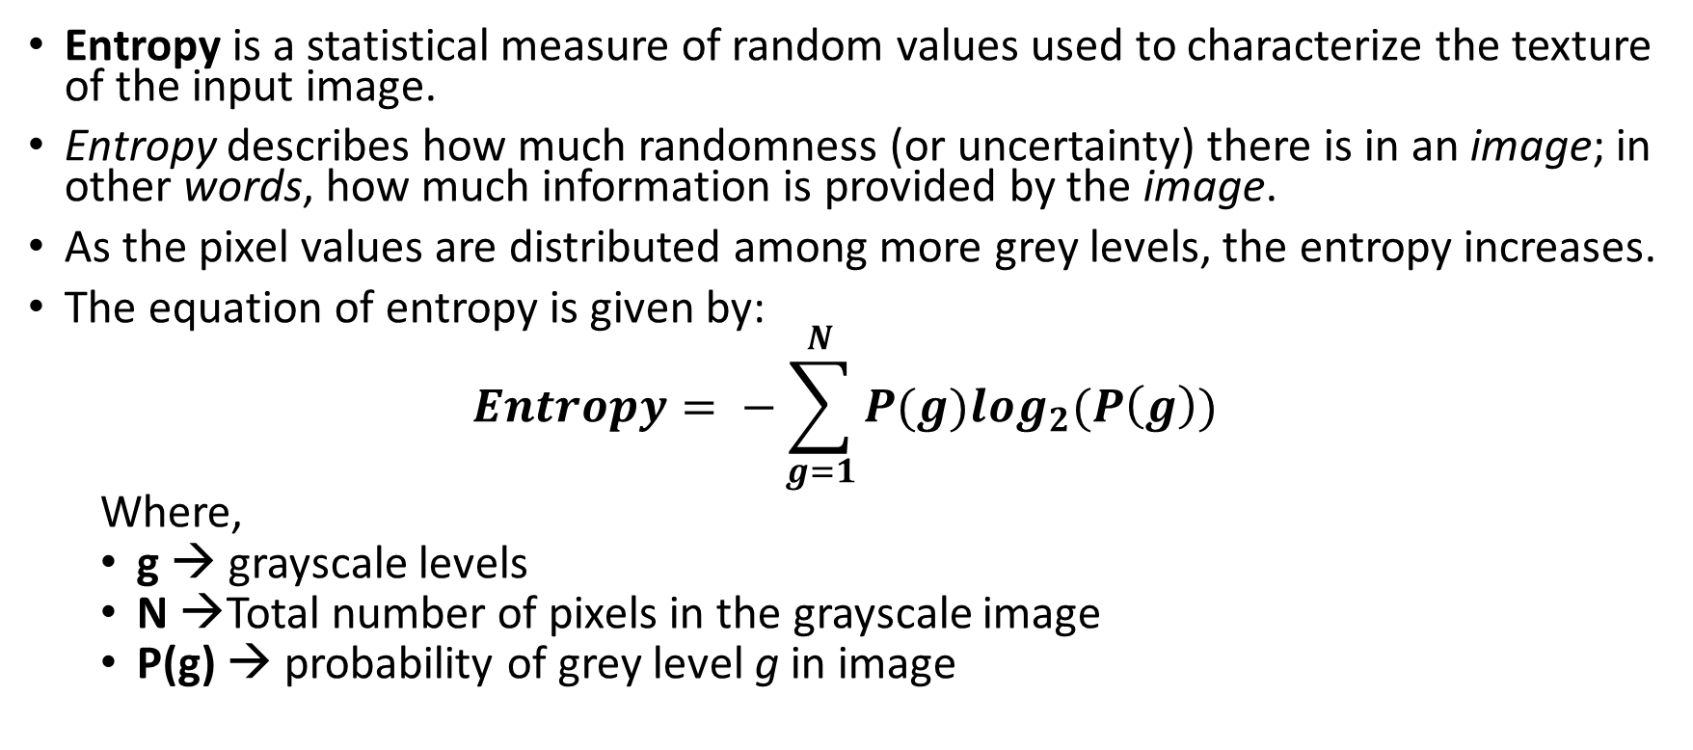
7. Entropy
Entropy is a statistical measure of random values used to characterize the texture of the input image.
Entropy describes how much randomness (or uncertainty) there is in an image; in other words, how much information is provided by the image.
As the pixel values are distributed among more grey levels, the entropy increases.
The equation of entropy is given by:
$$Entropy= −\sum_{g=1}^{N}{P(g)\log_{2}(P\left(g\right))}$$
  Where,
  g → grayscale levels
  N →Total number of pixels in the grayscale image
  P(g) → probability of grey level g in image

Slide 94
Mathematical model for energy and entropy
The following matrix will be considered for computing energy and entropy.
10 | 30 | 40 | 80 | 20 | 15
22 | 36 | 11 | 14 | 18 | 45
31 | 150 | 115 | 100 | 200 | 180
40 | 175 | 225 | 115 | 30 | 10
50 | 117 | 222 | 116 | 40 | 20
22 | 165 | 122 | 117 | 50 | 30
Mathematical model

Slide 95
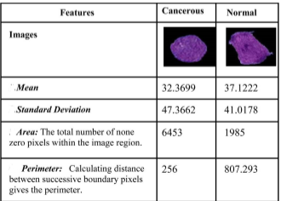


Slide 96
CLASSIFICATION

Slide 97
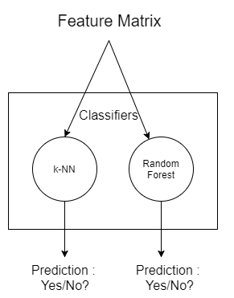
Classification
The features extracted will be used to form a feature matrix.
The feature matrix will be given as input to the classifier to predict if the cell is blast cell or not.

Slide 98
Thank You

Slide 99
k-NN Algorithm
k-Nearest Neighbours
K nearest neighbors is a simple algorithm that stores all available cases and classifies new cases based on a Euclidean distance.
The K-Nearest Neighbors (K-NN) for classification, are very “simple” algorithms , K-NN is a lazy learner because it doesn’t learn from the training data but “memorizes” the training dataset instead.
Input: k closest training examples
Output: Class membership is object is classified by majority vote of its neighbors
1. Determine parameter K= number of nearest neighbors.
2. Calculate the Euclidean distance between the query-instance and all the training samples.
3. Sort the distance and determine nearest neighbors based on the K^{th} minimum distance and assign a rank.
4. Gather the category the nearest neighbors.
5 .Use simple majority of the category of nearest neighbours as the prediction value of the query instance, if majority results in a tie then use distance measure as a prediction value.

Slide 100
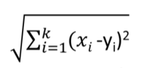
Euclidean Distance:
Euclidean distance is calculated as the square root of the sum of the squared differences between the new point xi and an existing point y_{i} across all input attributes i.
where x_{i} is the query instance and y_{i} is the training sample
Distance Measure:
Distance weighted measure = max ∑ W_{i}*I
where W_{i}=1/d(x’,y_{i})²
I=Indicator function that returns a value 1 if its argument is true else 0

Slide 101
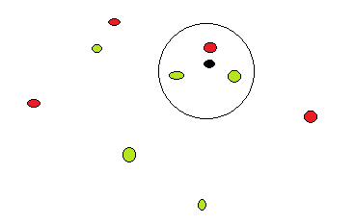
3-Nearest Neighbor
In this case k=3 , the green dots have class = good and red dots have class = Bad and the black dot is the sample under consideration in the given feature space.
Initially we calculate the Euclidean distance from the sample to all the points and we give a rank.
Since k=3 the first 3 ranks are taken and via majority voting the class of the sample is determined.
Mathematical model

Slide 102
2-Nearest Neighbor
One way to reduce the impact of k is to weight the influence of the nearest neighbors x_{i} according to it’s distance given by:
W_{i} =1/d(x ’,x_{i})²
Using weighted distance voting scheme the class label can be determined using the formula.
Distance weighted voting = max ∑w _{i} *I
(xi,yi)€D z
Where I is the indicator function that returns a value 1 if it’s argument is true and 0 otherwise

Slide 103
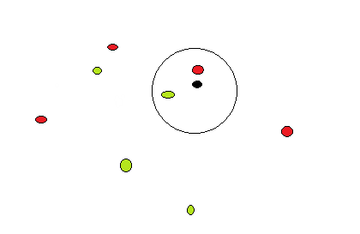
In the case when k=2,the Euclidean distance is calculated from the sample point to all other points
The rank is assigned based on the Euclidean distance.
The distance measure is calculated since we cannot determine the class of the sample using majority voting hence we calculate the distance measure for the two neighbors
The class of the greater distance measure is assigned to sample under consideration
Mathematical model

Slide 104
Random Forest

Slide 105
Random Forest
Random forests or random decision forests are an ensemble learning method for classification, that operate by constructing a multitude of decision trees at training time and outputting the class that is the mode of the classes.
Features:
It is unexcelled in accuracy among current algorithms.
It runs efficiently on large data bases.
Generated forests can be saved for future use on other data.
Stability - If the data is changed a little, the individual trees may change but the forest is relatively stable because it is a combination of many trees.

Slide 106
Random Forest Algorithm
Grow a forest of many trees.
Grow each tree on an independent bootstrap sample* from the training data.
At each node:
a. Select m variables at random out of all M possible variables (independently for each node).
b. Find the best split on the selected m variables.
Grow the trees to maximum depth (classification).
Vote the trees to get predictions for new data.
*Sample N cases at random with replacement

Slide 107
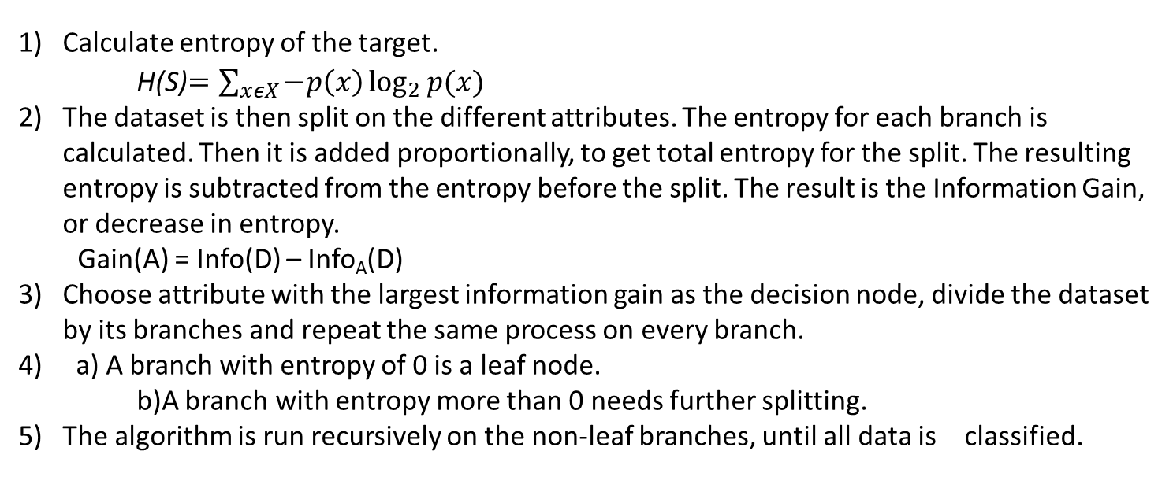
Decision Tree Algorithm
Calculate entropy of the target.
H(S)$=\sum_{xεX}{−p\left(x\right)\log_{2}{p(x)}}$
The dataset is then split on the different attributes. The entropy for each branch is calculated. Then it is added proportionally, to get total entropy for the split. The resulting entropy is subtracted from the entropy before the split. The result is the Information Gain, or decrease in entropy.
  Gain(A) = Info(D) – Info_{A}(D)
Choose attribute with the largest information gain as the decision node, divide the dataset by its branches and repeat the same process on every branch.
a) A branch with entropy of 0 is a leaf node.
b)A branch with entropy more than 0 needs further splitting.
5) The algorithm is run recursively on the non-leaf branches, until all data is classified.

Slide 108
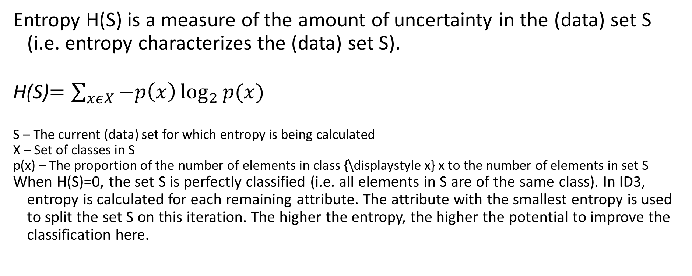
Entropy
Entropy H(S) is a measure of the amount of uncertainty in the (data) set S (i.e. entropy characterizes the (data) set S).
H(S)$=\sum_{xεX}{−p\left(x\right)\log_{2}{p(x)}}$
S – The current (data) set for which entropy is being calculated
X – Set of classes in S
p(x) – The proportion of the number of elements in class {\displaystyle x} x to the number of elements in set S
When H(S)=0, the set S is perfectly classified (i.e. all elements in S are of the same class). In ID3, entropy is calculated for each remaining attribute. The attribute with the smallest entropy is used to split the set S on this iteration. The higher the entropy, the higher the potential to improve the classification here.

Slide 109
Mathematical Model
ID | Home Owner (HO) | Marital Status(MS) | Annual Income (AI) | Job Type (JT) | Age | Has Leverage (HL) | Secondary Income Source (IS) | Defaulted?
1 | Yes | Single | 125k | Permanent | 35 | Yes | Yes | No
2 | No | Married | 100k | Permanent | 40 | No | Yes | No
3 | No | Single | 70k | Permanent | 37 | Yes | Yes | No
4 | Yes | Married | 120k | Temporary | 45 | Yes | No | No
5 | No | Divorced | 95k | Temporary | 25 | No | No | Yes
6 | No | Married | 60k | Permanent | 28 | No | Yes | No
7 | Yes | Divorced | 220k | Temporary | 36 | No | Yes | No
8 | No | Single | 85k | Temporary | 24 | No | No | Yes
9 | No | Married | 75k | Permanent | 30 | Yes | No | No
10 | No | Single | 90k | Temporary | 27 | No | No | Yes

Slide 110
After randomly taking subset of dataset
ID | HO | MS | JT | Defaulted
1 | Yes | S | P | No
4 | Yes | M | T | No
3 | No | S | P | No
2 | No | M | P | No
5 | No | D | T | Yes
6 | No | M | P | No
7 | Yes | D | T | No
9 | No | M | P | No
8 | No | S | T | Yes
2 | No | M | P | No
HO – Home owner
MS - Married/Single/Divorced
JT- Job Type

Slide 111
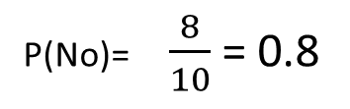
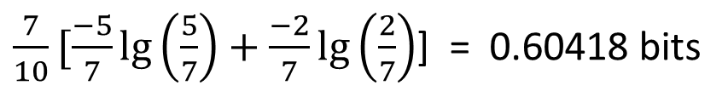
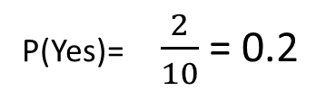
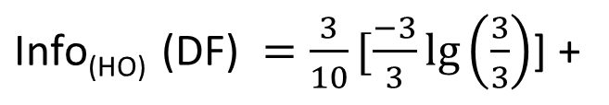
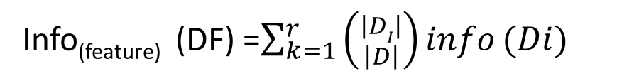
Instances
Total no of Yes : 2
Total no of No : 8
P(Yes)= $\frac{2}{10}$ = 0.2
P(No)= $\frac{8}{10}$ = 0.8
$\text{Info}\text{(}\text{DF}\text{)}= \frac{−2}{10}\lg\left(\frac{2}{10}\right) −$ $\frac{−8}{10}\lg\left(\frac{8}{10}\right) = 0.721928$
Home Owner(HO)
Info_{(feature)} (DF) =$\sum_{k=1}^{r}{\left({\left|DI\right| \atop \left|D\right|}\right)info}(Di)$
$\text{Info}\text{(}\text{HO}\text{) }\text{(}\text{DF}\text{) }=\frac{3}{10}[\frac{−3}{3}\lg\left(\frac{3}{3}\right)$] +
$\frac{7}{10}[\frac{−5}{7}\lg\left(\frac{5}{7}\right)+\frac{−2}{7}\lg\left(\frac{2}{7}\right)$] = 0.60418 bits
yes
No
$$\text{g}\text{ain}\text{(}\text{HO}\text{) }\text{(}\text{DF}\text{) = }\text{0}\text{.}\text{72198 }\text{− }\text{0}\text{.}\text{60418 }\text{= }\text{0}\text{.}\text{11748 }$$

Slide 112
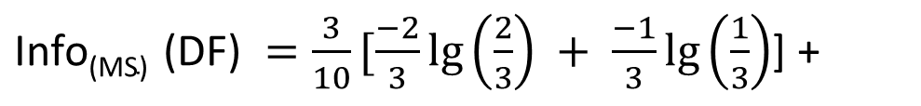
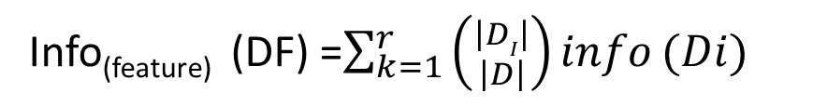
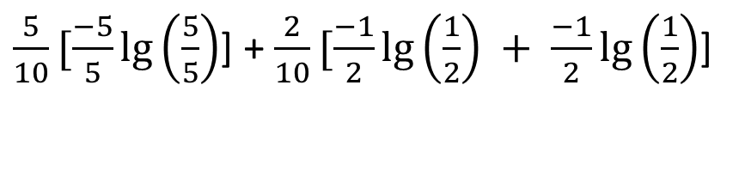
Marital status (MS)
Info_{(feature)} (DF) =$\sum_{k=1}^{r}{\left({\left|DI\right| \atop \left|D\right|}\right)info}(Di)$
$\text{Info}\text{(}\text{MS}\text{) }\text{(}\text{DF}\text{) }=\frac{3}{10}[\frac{−2}{3}\lg\left(\frac{2}{3}\right) + \frac{−1}{3}\lg\left(\frac{1}{3}\right)$] +
$\frac{5}{10}[\frac{−5}{5}\lg\left(\frac{5}{5}\right)$] + $\frac{2}{10}[\frac{−1}{2}\lg\left(\frac{1}{2}\right) + \frac{−1}{2}\lg\left(\frac{1}{2}\right)$]
s
m
d
= 0.47548875
$$\text{g}\text{ain}\text{(}\text{MS}\text{) }\text{(}\text{DF}\text{) = 0.72198 − 0.47548875 = 0.264379125 }$$

Slide 113
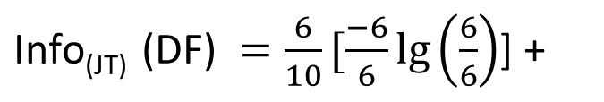
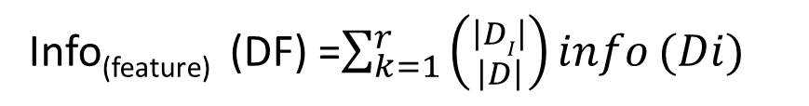

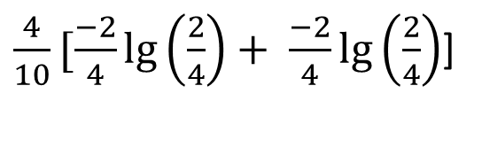
JOB TYPE (JT)
Info_{(feature)} (DF) =$\sum_{k=1}^{r}{\left({\left|DI\right| \atop \left|D\right|}\right)info}(Di)$
$\text{Info}\text{(}\text{JT}\text{) }\text{(}\text{DF}\text{) }=\frac{6}{10}[\frac{−6}{6}\lg\left(\frac{6}{6}\right)$] +
$\frac{4}{10}[\frac{−2}{4}\lg\left(\frac{2}{4}\right)+ \frac{−2}{4}\lg\left(\frac{2}{4}\right)$]
P
T
= 0.4
$$\text{g}\text{ain}\text{(}\text{JT}\text{) }\text{(}\text{DF}\text{) = }\text{0}\text{.}\text{72198 }\text{− }\text{0}\text{.}\text{4 }\text{= }\text{0}\text{.}\text{321928 }$$

Slide 114
$$\text{g}\text{ain}\text{(}\text{HO}\text{) }\text{(}\text{DF}\text{) = 0.72198 − 0.60418 = 0.11748 }$$
$$\text{g}\text{ain}\text{(}\text{MS}\text{) }\text{(}\text{DF}\text{) = 0.72198 − 0.47548875 = 0.264379125 }$$
$$\text{g}\text{ain}\text{(}\text{JT}\text{) }\text{(}\text{DF}\text{) = 0.72198 − 0.4 = 0.321928 }$$
Since the gain for Job type(JT) is high we select (JT) as the split point
JT
T
p

Slide 115
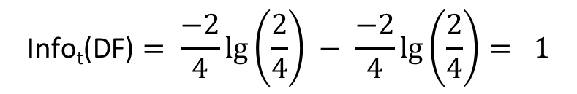
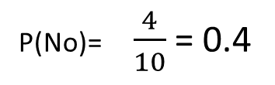
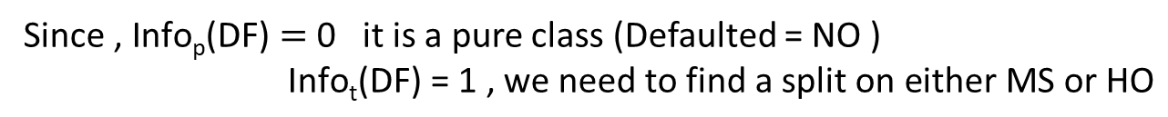
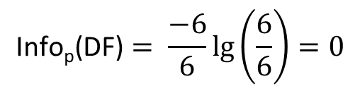
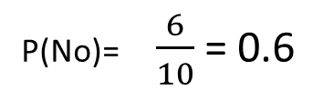
To find the sub-nodes for JT
FOR T
FOR P
P(No)= $\frac{4}{10}$ = 0.4
P(No)= $\frac{6}{10}$ = 0.6
$$\text{Info}\text{t}\text{(}\text{DF}\text{)}= \frac{−2}{4}\lg\left(\frac{2}{4}\right) − \frac{−2}{4}\lg\left(\frac{2}{4}\right)= 1$$
$$\text{Info}\text{p}\text{(}\text{DF}\text{)}= \frac{−6}{6}\lg\left(\frac{6}{6}\right)=0$$
$\text{Since} \text{, }\text{Info}\text{p}\text{(}\text{DF}\text{)}=$ 0 it is a pure class (Defaulted = NO )
$\text{Info}\text{t}\text{(}\text{DF}\text{)}\text{ = }\text{1 }\text{, }\text{we} \text{need} \text{to} \text{find} \text{a} \text{split} \text{on} \text{either} \text{MS} \text{or} \text{HO}$

Slide 116
Current Tree
JT
T
p
Defaulted = NO
Tid | HO | MS | JT | Defaulted
4 | Yes | M | T | No
5 | No | D | T | Yes
7 | Yes | D | T | No
8 | No | S | T | Yes

Slide 117
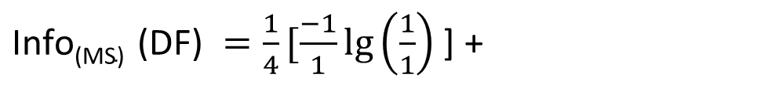
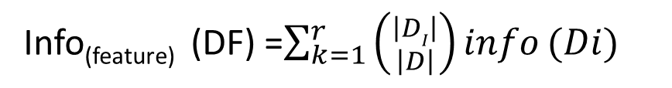

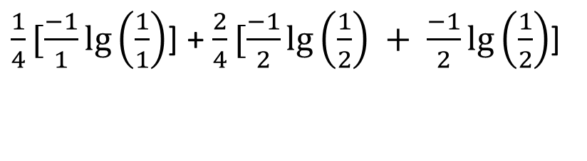
Married/Single (MS)
Info_{(feature)} (DF) =$\sum_{k=1}^{r}{\left({\left|DI\right| \atop \left|D\right|}\right)info}(Di)$
$\text{Info}\text{(}\text{MS}\text{) }\text{(}\text{DF}\text{) }=\frac{1}{4}[\frac{−1}{1}\lg\left(\frac{1}{1}\right)$] +
$\frac{1}{4}[\frac{−1}{1}\lg\left(\frac{1}{1}\right)$] + $\frac{2}{4}[\frac{−1}{2}\lg\left(\frac{1}{2}\right) + \frac{−1}{2}\lg\left(\frac{1}{2}\right)$]
s
m
d
= 0.5
$$\text{g}\text{ain}\text{(}\text{MS}\text{) }\text{(}\text{DF}\text{) = 1 − 0.5 = 0.5 }$$

Slide 118
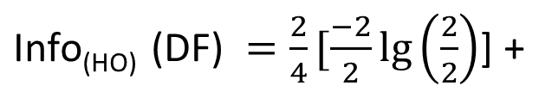
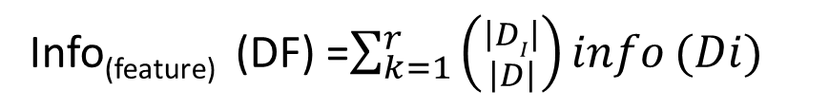

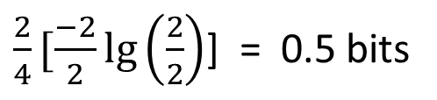
Home Owner(H0)
Info_{(feature)} (DF) =$\sum_{k=1}^{r}{\left({\left|DI\right| \atop \left|D\right|}\right)info}(Di)$
$\text{Info}\text{(}\text{HO}\text{) }\text{(}\text{DF}\text{) }=\frac{2}{4}[\frac{−2}{2}\lg\left(\frac{2}{2}\right)$] +
$\frac{2}{4}[\frac{−2}{2}\lg\left(\frac{2}{2}\right)$] = 0.5 bits
yes
No
$$\text{gain}\text{(}\text{HO}\text{) }\text{(}\text{DF}\text{) = }\text{1 }\text{− }\text{0}\text{.}\text{5}\text{= }\text{0}\text{.}\text{5}$$

Slide 119


$$\text{gain}\text{(}\text{HO}\text{) }\text{(}\text{DF}\text{) = 1 − 0.5= 0.5}$$
$$\text{gain}\text{(}\text{MS}\text{) }\text{(}\text{DF}\text{) = 1 − 0.5= 0.5}$$
Since the gain for Home Owner(HO) and Married/Single is same we can choose either
HO or MS as the split point.
Consider, we choose MS , then the tree would look as follow
JT
T
P
MS
Defaulted = NO

Slide 120




To find the sub nodes for MS
Tid | HO | MS | JT | Defaulted
4 | Yes | M | T | No
5 | No | D | T | Yes
7 | Yes | D | T | No
8 | No | S | T | Yes
FOR S (Single)
$\text{Info}\text{s}\text{(}\text{DF}\text{)}= \frac{−1}{1}\lg{ \left(\frac{1}{1}\right) }$ = 0
FOR M (Married)
$\text{Info}\text{m}\text{(}\text{DF}\text{)}= \frac{−1}{1}\lg\left(\frac{1}{1}\right)$ = 0
FOR D (Divorced)
$\text{Info}\text{d}\text{(}\text{DF}\text{)}= \frac{−1}{2}\lg\left(\frac{1}{2}\right)−\frac{−1}{2}\lg\left(\frac{1}{2}\right)$ = 1
$\text{Since}\text{ , }\text{Info}\text{p}\text{(}\text{DF}\text{)}=$ $\text{Info}\text{s}\text{(}\text{DF}\text{)}\text{ = 0}$ it is a pure class.
$\text{single}\text{ − }\text{Defaulted}\text{ = }\text{yes} \text{Married}\text{ − }\text{Defaulted}\text{ = }\text{No}$

Slide 121
Current Tree
JT
T
P
MS
Defaulted = NO
S
D
Defaulted = YES
M
Defaulted = NO

Slide 122




To find info and gain for Home owner(HO)
Info_{(feature)} (DF) =$\sum_{k=1}^{r}{\left({\left|DI\right| \atop \left|D\right|}\right)info}(Di)$
$\text{Info}\text{(}\text{HO}\text{) }\text{(}\text{DF}\text{) }=\frac{1}{2}[\frac{−1}{1}\lg\left(\frac{1}{1}\right)$] +
$\frac{1}{2}[\frac{−1}{1}\lg\left(\frac{1}{1}\right)$]
JT
T
p
yes
no
MS
Defaulted = NO
= 0
S
D
HO
Defaulted = YES
M
$$\text{g}\text{ain}\text{(}\text{MS}\text{) }\text{(}\text{DF}\text{) = 1 − 0 = }\text{1}$$
Defaulted = NO
YES
NO
Split on Home Owner(HO)

Slide 123
To find leaf nodes for HO
FOR yes
Tid | HO | MS | JT | Defaulted
5 | No | D | T | Yes
7 | Yes | D | T | No
$\text{Info}\text{s}\text{(}\text{DF}\text{)}= \frac{−1}{1}\lg{ \left(\frac{1}{1}\right) }$ = 0
FOR NO
$\text{Info}\text{m}\text{(}\text{DF}\text{)}= \frac{−1}{1}\lg\left(\frac{1}{1}\right)$ = 0
The split is pure

Slide 124
Final tree
JT
T
p
MS
Defaulted = NO
S
D
Defaulted = YES
M
Defaulted = NO
HO
YES
NO
Defaulted = NO
Defaulted = YES

Slide 125
After randomly taking subset of dataset
ID | MS | Age | IS | Defaulted
1 | S | 35 | YES | NO
3 | S | 37 | YES | NO
4 | M | 45 | NO | NO
5 | D | 25 | NO | YES
2 | M | 40 | YES | NO
8 | S | 24 | NO | YES
6 | M | 28 | YES | NO
10 | S | 27 | NO | YES
2 | M | 40 | YES | NO
1 | S | 35 | YES | NO

Slide 126
To discretize continuous attribute i.e. Age
$\text{Info}\text{(}\text{DF}\text{)}= \frac{−3}{10}\lg\left(\frac{3}{10}\right) −$ $\frac{−7}{10}\lg\left(\frac{7}{10}\right) = 0.8813$
YES | YES | YES | NO | NO | NO | NO | NO | NO | NO
24 | 25 | 27 | 28 | 35 | 35 | 37 | 40 | 40 | 45
27
Therefore, we divide into 2 categories i.e. <=27 and >27

Slide 127




Marital Status
Info_{(feature)} (DF) =$\sum_{k=1}^{r}{\left({\left|DI\right| \atop \left|D\right|}\right)info}(Di)$
$\text{Info}\text{(}\text{MS}\text{) }\text{(}\text{DF}\text{) }=\frac{5}{10}[\frac{−2}{5}\lg\left(\frac{2}{5}\right)$+$\frac{−3}{5}\lg\left(\frac{3}{5}\right)$] +
$\frac{4}{10}[\frac{−4}{4}\lg\left(\frac{4}{4}\right)$] + $\frac{1}{10}[\frac{−1}{1}\lg\left(\frac{1}{1}\right)$] = 0.4854 bits
S
M
$$\text{g}\text{ain}\text{(}\text{MS}\text{) }\text{(}\text{DF}\text{) = }\text{0}\text{.}\text{8813}\text{− }\text{0}\text{.}\text{4854}\text{=}\text{0}\text{.}\text{3956}$$

Slide 128




Age
Info_{(feature)} (DF) =$\sum_{k=1}^{r}{\left({\left|DI\right| \atop \left|D\right|}\right)info}(Di)$
$\text{Info}\text{(}\text{age}\text{) }\text{(}\text{DF}\text{) }=\frac{3}{10}[\frac{−3}{3}\lg\left(\frac{3}{3}\right)$] +
$\frac{7}{10}[\frac{−7}{7}\lg\left(\frac{7}{7}\right)$] = 0 bits
<=27
>27
$$\text{g}\text{ain}\text{(}\text{age}\text{) }\text{(}\text{DF}\text{) = }\text{0}\text{.}\text{8813}\text{− }\text{0 }\text{= }\text{0}\text{.}\text{8813}$$

Slide 129




Secondary Income source
Info_{(feature)} (DF) =$\sum_{k=1}^{r}{\left({\left|DI\right| \atop \left|D\right|}\right)info}(Di)$
$\text{Info}\text{(}\text{IS}\text{) }\text{(}\text{DF}\text{) }=\frac{6}{10}[\frac{−6}{6}\lg\left(\frac{6}{6}\right)$] +
$\frac{4}{10}[\frac{−4}{4}\lg\left(\frac{4}{4}\right)$] = 0.3245 bits
YES
No
$$\text{g}\text{ain}\text{(}\text{IS}\text{) }\text{(}\text{DF}\text{) = }\text{0}\text{.}\text{8813}\text{−}\text{0}\text{.}\text{3245}\text{= }\text{0}\text{.}\text{5568}$$

Slide 130



AGE
<=27
>27
$$\text{g}\text{ain}\text{(}\text{MS}\text{) }\text{(}\text{DF}\text{) = 0.8813− 0.4854=0.3956}$$
$$\text{g}\text{ain}\text{(}\text{age}\text{) }\text{(}\text{DF}\text{) = 0.8813− 0 = 0.8813}$$
$$\text{g}\text{ain}\text{(}\text{IS}\text{) }\text{(}\text{DF}\text{) = 0.8813−}\text{0.3245}\text{= 0.5568}$$
Gain(age) is maximum hence we split on Age.

Slide 131


To Find Leaf Nodes of Age.
$\text{Info}\text{(}\text{age}\text{) }\text{(}\text{DF}\text{) }=\frac{3}{3}[\frac{−3}{3}\lg\left(\frac{3}{3}\right)$] = 0 bits
AGE
<=27
<=27
>27
$\text{Info}\text{(}\text{age}\text{) }\text{(}\text{DF}\text{) }=\frac{7}{7}[\frac{−7}{7}\lg\left(\frac{7}{7}\right)$] = 0 bits
Defaulted = YES
Defaulted = NO
>
The split is pure

Slide 132
Similarly we generated the following trees
JT
T
P
AI
Defaulted = NO
<=97
>97
Defaulted = NO
Defaulted = YES

Slide 133
2
1
JT
AGE
T
p
<=27
>27
MS
Defaulted = NO
S
D
Defaulted = YES
Defaulted = NO
Defaulted = YES
M
Defaulted = NO
HO
YES
NO
Defaulted = NO
Defaulted = YES

Slide 134
IS
NO
YES
JT
HL
Defaulted = NO
T
p
NO
YES
AI
Defaulted = NO
<=97
>97
Defaulted = NO
Defaulted = YES
Defaulted = NO
Defaulted = YES
3
4

Slide 135
CONSIDER FOLLIOWING QUERY GIVEN TO THE CLASSIFER
ID | Home Owner (HO) | Marital Status(MS) | Annual Income (AI) | Job Type (JT) | Age | Has Leverage (HL) | Secondary Income Source (IS) | Defaulted?
1 | Yes | Single | 125k | Permanent | 35 | NO | NO | ?
OUTPUT FROM
TREE 1 : NO
TREE 2: NP
TREE 3: YES
TREE 4: NO
By majority voting the output class in NO

Slide 136
Random Forest | k-Nearest Neighbours
Random forest algorithm is based on decision tree learning | k-NN is based on distance measure from neighbours
Eager Learner, since it has a model fitting or training step | Lazy Learner, since it does not have a training phase.
Random Forest classifier does not require such lookups as it has in-memory classification model ready. | Since KNN performs on-the-spot learning, it requires frequent database lookups, hence, can be computationally expensive.
Can handle very well high dimensional spaces as well as large number of training examples | Work well for a small number of dimensions, but not a high number of dimensions
Disadvantage is that individual trees may overfit data, but this can be overcomed by using an ensemble i.e. Random Forest | Disadvantage is that it takes up a lot of memory to run (storing all the instances)

Slide 137
References
Minal D. Joshi, A.H.Karode, S.R.Suralkar, Department of E&TC, SSBT College of Engineering, NMU University, Jalgaon, “White Blood Cells Segmentation and Classification to Detect Acute Leukemia”, IJECET.
Fabio Scotti IEEE Member Universit`a degli Studi di Milano, Department of Information Technologies, via Bramante 65, 26013 Crema, Italy, “Morphlogical Classification of Blood Leukcocytes by Microscopic Images”, IEEE2011.
Fauzia Kasmin, Anton Prabuwono, Faculty of Information and Communication Technology, Universiti Teknikal Malaysia Melaka Hang ,“Detection of Leukemia in Human Blood Sample based on Microscopic Images : A Study”, Journal of Theoretical and Applied Information Technology, 2012. Vol. 46 No.2
Shaochun Jia, Xiuzhen Hu, Lixia Sun Department of Physics, College of Sciences Inner Mongolia University of Technology, Huhhot, China, “The Comparison between Random Forest and Support Vector Machine Algorithm for Predicting β-Hairpin Motifs in Protein”, Engineering, 2013, 5, 391-395
H.T. Madhloom, S.A. Kareem, University of Malaya, Malaysia, “An Automated White Blood Cell Nucleus Localization and Segmentation using Image Arithmetic and Automatic Threshold”, Journal of Applied Sciences ,2010.

Slide 138
Fauzia Kasmin, Anton Prabuwono, Faculty of Information and Communication Technology, Universiti Teknikal Malaysia Melaka Hang ,“Detection of Leukemia in Human Blood Sample based on Microscopic Images : A Study”, Journal of Theoretical and Applied Information Technology, 2012. Vol. 46 No.2
Prakash Kumar, Saumya Ranjan Giri, Ganesh Rama Hegde, Kanchan Verma IL&FS Technologies, Bhubaneswar, “A Novel Algorithm to Extract Connected Components in a Binary Image of Vehicle License Plates”, IJECCT 2012, Vol. 2
Eng. Ayman M Bahaa Eldeen Sadeq, Prof. Dr. Abdel-Moneim A. Wahdan, Prof. Dr. Hani M. K. Mahdi Faculty of Engineering, Ain Shams University, “Edge Detection Of Binary Images Using The Method Of Masks.”
K Benkrid and D Crookes School of Computer Science, The Queen’s University of Belfast “Design and FPGA Implementation of a Perimeter Estimator”

Slide 139
THANK YOU

